Slide 1
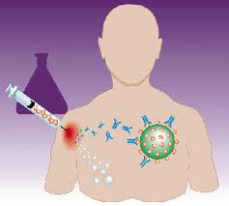
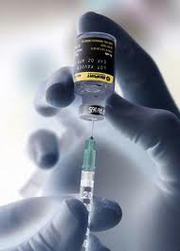
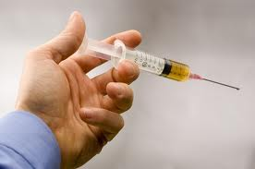
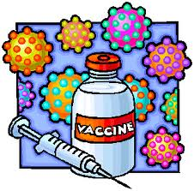
Infectious Diseases
Lesson 5.5

Slide 2
Lesson Objectives:
After finishing today’s lesson, you will be able to:
describe the pros and cons of the four main types of vaccines.
explain how vaccines work.
describe the qualities of a good vaccine.

Slide 3
Do Now
What qualities do you want in a good vaccine?

Slide 4
What qualities do you want in a good vaccine?
Protection
Sterilizing immunity – Totally prevented or cleared by the immune system
vs.
Non-sterilizing immunity – Pathogen is controlled and disarmed but stays in your system
Number of doses
Is one shot enough?
Immunological memory
Do you need to be revaccinated every year?
Practicality
Does the vaccine need refrigeration for storage?
Economical
Is it affordable?

Slide 5
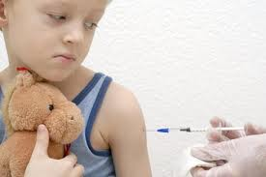
Discussion: How do vaccines work?
They stimulate immune memories in the absence of a dangerous infection!

Slide 6
A vaccine contains antigens that trick the immune system into responding

Slide 7
A vaccine contains antigens that trick the immune system into responding:
The antigen-presenting cell activates the Helper T-cell
T
cell
T
cell
1.
Antigen-presenting
cell
The activated Helper T-cell stimulates the
B cell to make memory B cells and antibodies
T
cell
B
cell
B cell
2.

Slide 8
The first vaccine

Slide 9
There are four main types of vaccines
Killed (inactivated) microbes
Live but weakened (attenuated) microbes
Microbe antigens only
Recombinant microbes engineered to contain antigens without infectivity

Slide 10
Killed (inactivated) microbes
Usually killed with heat, chemicals, or radiation.
Pros: generates strong immune response because it contains many antigens.
Cons: it can become dangerous if manufacturing errors are made and the virus is not killed, especially for people who are immunocompromised.
Examples: flu shot, injectable form
1.
Microbe that has
been completely
Inactivated (killed).

Slide 11
Live but weakened (attenuated) microbe
The microbe can be weakened (attenuated) by selection or chemicals.
Pros: generates very strong immune response because it will replicate a little bit in your body.
Cons: Cannot be used in immunocompromised people because it can make them sick.
Examples: flu shot, the nasal spray form
2.
Microbe that has
been weakened
(attenuated).

Slide 12
Microbe antigens only
These are just the antigens themselves.
Pros: very safe, no danger of getting sick.
Cons: they often don’t activate the innate immune system without help from an adjuvant.
Examples: tetanus vaccine
3.
Parts (antigens) of a microbe
4.
Virus that has been genetically engineered so it is not infective
(recombinant virus).

Slide 13
Recombinant microbes engineered to have antigens without infectivity
These are microbes (mostly viruses) that are made of the capsid proteins only: no genetic material
Pros: you have control over the process, very safe (cannot make you sick because there is no genetic material), great immune response.
Cons: hard to make, needs lots of bioengineering and research.
Examples: Hepatitis B and HPV vaccines
4.
The microbe has been genetically engineered, so it is not infective

Slide 14
Which type of vaccine do you think is the best?
1.
3.
Parts (antigens) of a microbe
Microbe that has
been completely
Inactivated (killed).
2.
4.
Microbe that has
been weakened
(attenuated).
The microbe has been genetically engineered, so it is not infective.

Slide 15
Wrap Up
Why do so many vaccines cause side effects?

Slide 16
Homework
Prepare for the Great Debate!

